Slide 1
Gender Prediction Based on Handwriting
Akarsha Sehwag - 2015010
Aayushi Malik - 2015003

Slide 2
Aim
Our aim in this project is to learn the various feature extraction techniques required for writer prediction through handwriting analysis. We will then apply some classifiers on the feature set and compare the performance of different classifiers with different feature sets.
Some of the features that are used are:
Curvature features (f1)
Chain Code Based features (f2)
Contour Direction features (f3)
Contour Hinge features (f4)
Tortuosity features (f5)
Edge based direction features (f6)
Direction features (f7)
The first four features were implemented by us and the last three were given in the dataset.

Slide 3
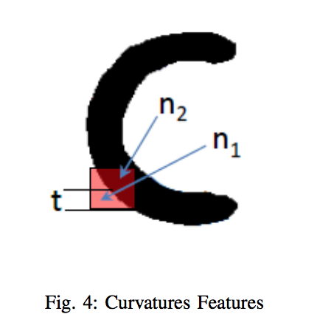
Curvature Features
The curvature features are used to extract the curvature
of the characters.
To calculate the curvature features, a window (of size
5x5) in our case is moved over the image. Then, for each
pixel, it is calculated as C = (n₁ - n₂)/(n₁ + n₂) where n₁ is
the number of pixels in the background and n₂ is the
number of features in the foreground. After calculating
this value for every pixel, a PDF of 25 dimensions is
created.

Slide 4
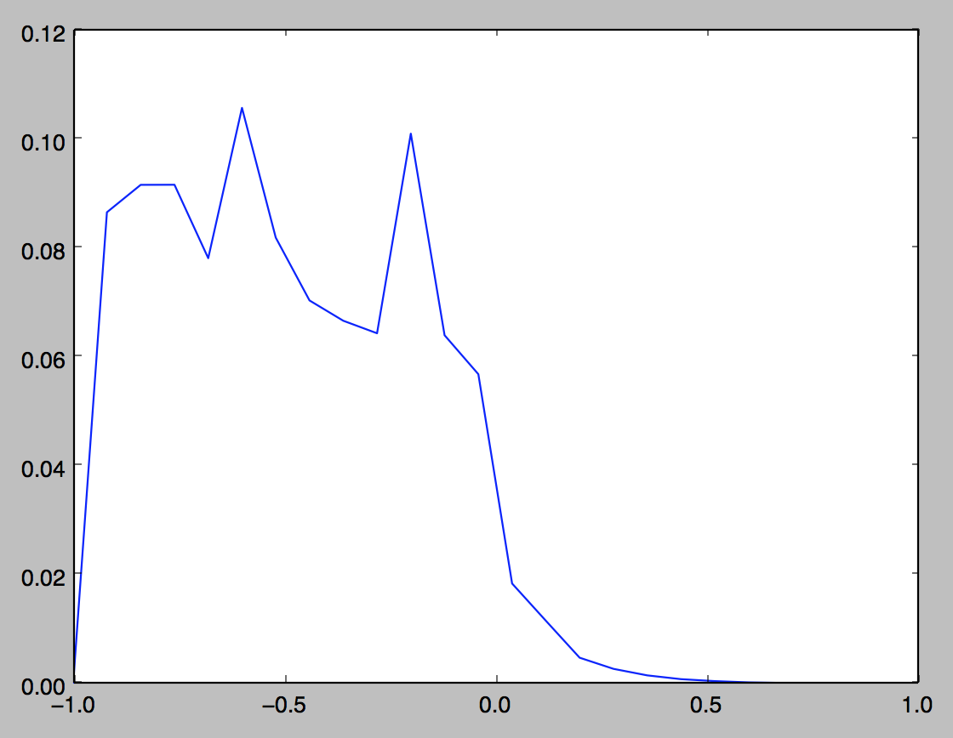
Curvature Features

Slide 5
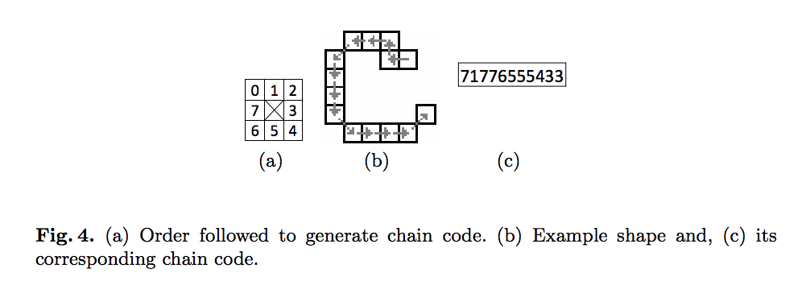
Chain Code Features
Chain code features were calculated by moving over the contour of the text and assigning a value to every pixel based on its location with respect to the location of the previous pixel.
An 8-dimensional PDF was formed by taking single values from the chain code list. Additionally, a 64-dimensional PDF was formed by taking pairwise values from the chain code list.

Slide 6
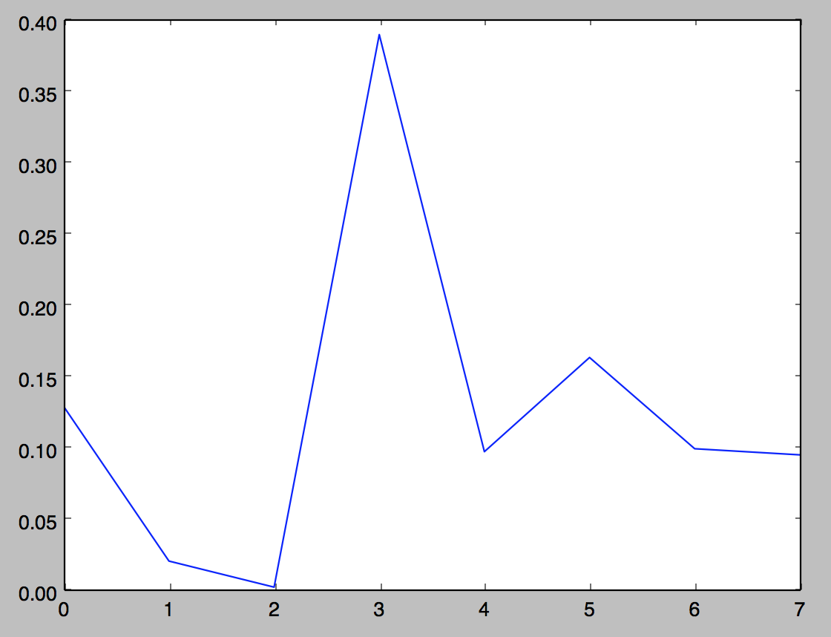
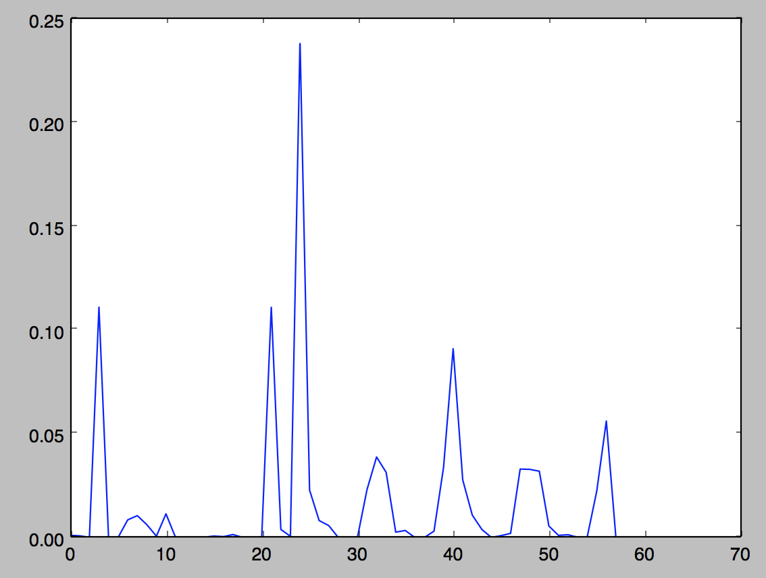
Chain Code Features
8-dimensional PDF
(b) 64-dimensional PDF

Slide 7
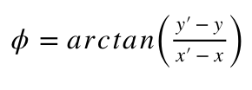
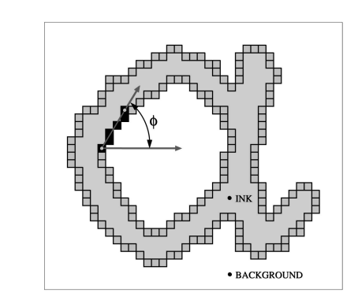
Contour Direction Features
This feature gives the overall slant in the handwriting of the writer. For each pixel (x, y) on the contour, the contour angle with the horizontal axis is calculated by using a 11x11 window and finding another pixel on the contour (x’, y’) that lies on the boundary of the window. Then, the angle is given by:

Slide 8
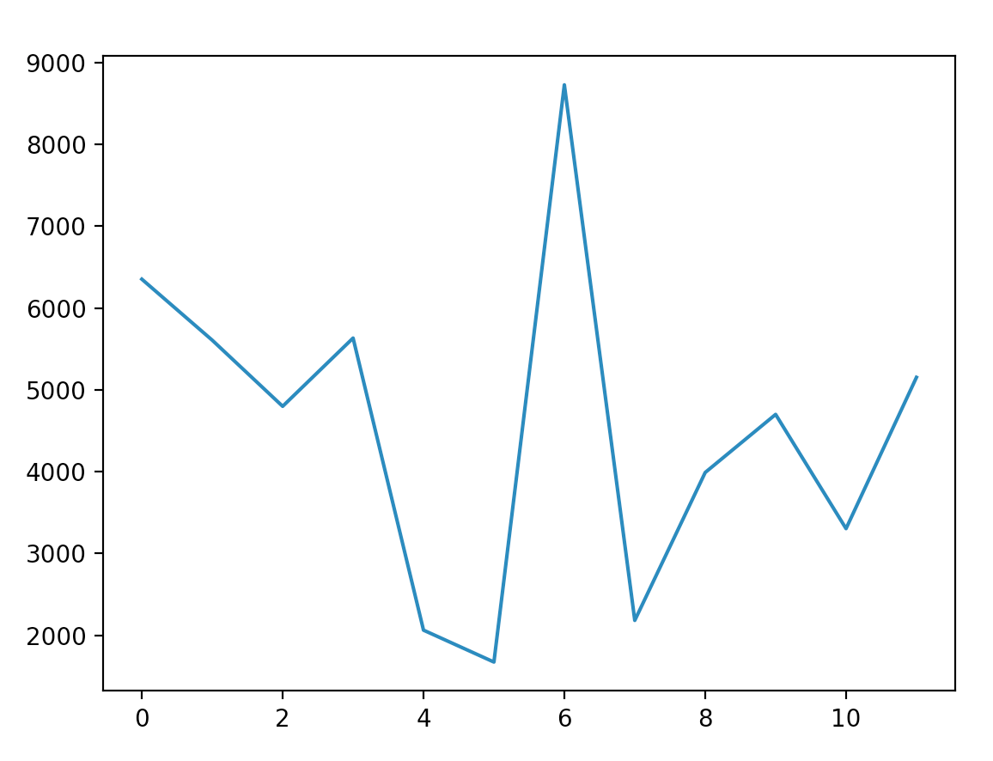
Contour Direction Features

Slide 9
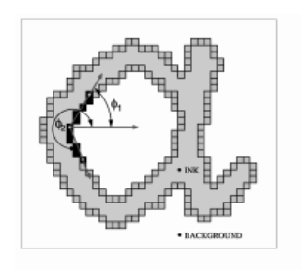
Contour - Hinge Features
To capture the curvature of the ink trace besides orientation, Hinge features introduced
Idea is to consider not just one but two contour fragments attached at a common end pixel
Then compute the joint probability distribution of the orientations of the two legs with the horizontal.

Slide 10

Tortuosity Features
This feature makes distinguishing between fast and slow writers possible as fast writers have a smooth handwriting while slow writers have a twisted handwriting. A 20 dimensional feature vector is used in which, for a pixel p, a 10 dimensionsional PDF represents the longest line segment through p and a 10 dimensional feature represents the angle of the longest line segment. [1]

Slide 11
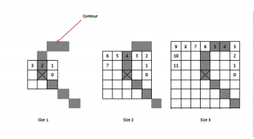
Edge Direction Features

Slide 12
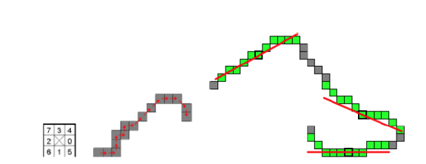
Direction Features

Slide 13
Results
The following results on accuracy were obtained:
Classifier/ Feature Set | (f1+f2+f5+f6+f7) | (f1+f2+f5+f6+f7) Using grid search | (f1+f2+f3+f4) | (f1+f2+f3+f4+f5)
SVM | 0.62 | 0.707 | 0.66 | 0.731
Random Forest Classifier | 0.725 | 0.704 | 0.62 | 0.716

Slide 14
Conclusion
From the results we can conclude that using the feature set with curvature features, chain code based features, contour direction features, contour hinge features and tortuosity features (f1+f2+f3+f4+f5) and using the SVM classifier gives the highest accuracy.
When Random Forest classifier is used the feature set with curvature features, chain code based features, tortuosity features, direction features and edge based direction features (f1+f2+f5+f6+f7) gives the highest accuracy.

Slide 15
References
[1]https://pdfs.semanticscholar.org/f1af/831002fe0ec13d0ee515dda498ac8008c4d7.pdf
[2]https://www.researchgate.net/profile/Marcus_Liwicki/publication/228777858_Automatic_Detection_of_Gender_and_Handedness_from_On-Line_Handwriting/links/0c9605327ee2f4267f000000.pdf
[3]https://ieeexplore.ieee.org/document/6628847
[4]https://ieeexplore.ieee.org/stamp/stamp.jsp?tp=&arnumber=4107573&fbclid=IwAR1QaZc2-juf3_OLe5JpgvBDE_ZzeopyMCGoucQqPLUPUmpHSS82aXHtUZk&tag=1

